Slide 1

Task 3
Internship Studio’s Ethical Hacking Internship
Name : Piyush Kumar E-mail: piyushkumar61090@gmail.com Contact no.: 7667517759

Slide 2
Insecure Transmission Vulnerability Found
Site Name: Acunetix
URL : http://testasp.vulnweb.com/
Details : In the above mentioned site transfer of Data is found to be done using HTTP instead of HTTPS which very insecure, the passwords while registering for new account or while logging in are transferred using HTTP which can easily be intercepted and exploited.
Impact: An attacker may:
Steal sensitive information like password by intercepting
Solution:
Transfer the working of all the forms on this site which carry sensitive information like passwords from HTTP to HTTPS, So even if an attacker intercepts the connection he still won’t be able to get important information like passwords easily.

Slide 3
Steps to reproduce :
Set up BurpSuite to intercept data from browser at it’s manual proxy
Visit the site and go to register page (forward all the requests till here in BurpSuite)
Now fill the form and submit the form for registration
Now intercept the request and search in the raw code, you will find all the details including password
Repeat the above steps at login page too.
Includes snapshots of Registration page and Login page with intercepted details in next few slides

Slide 4
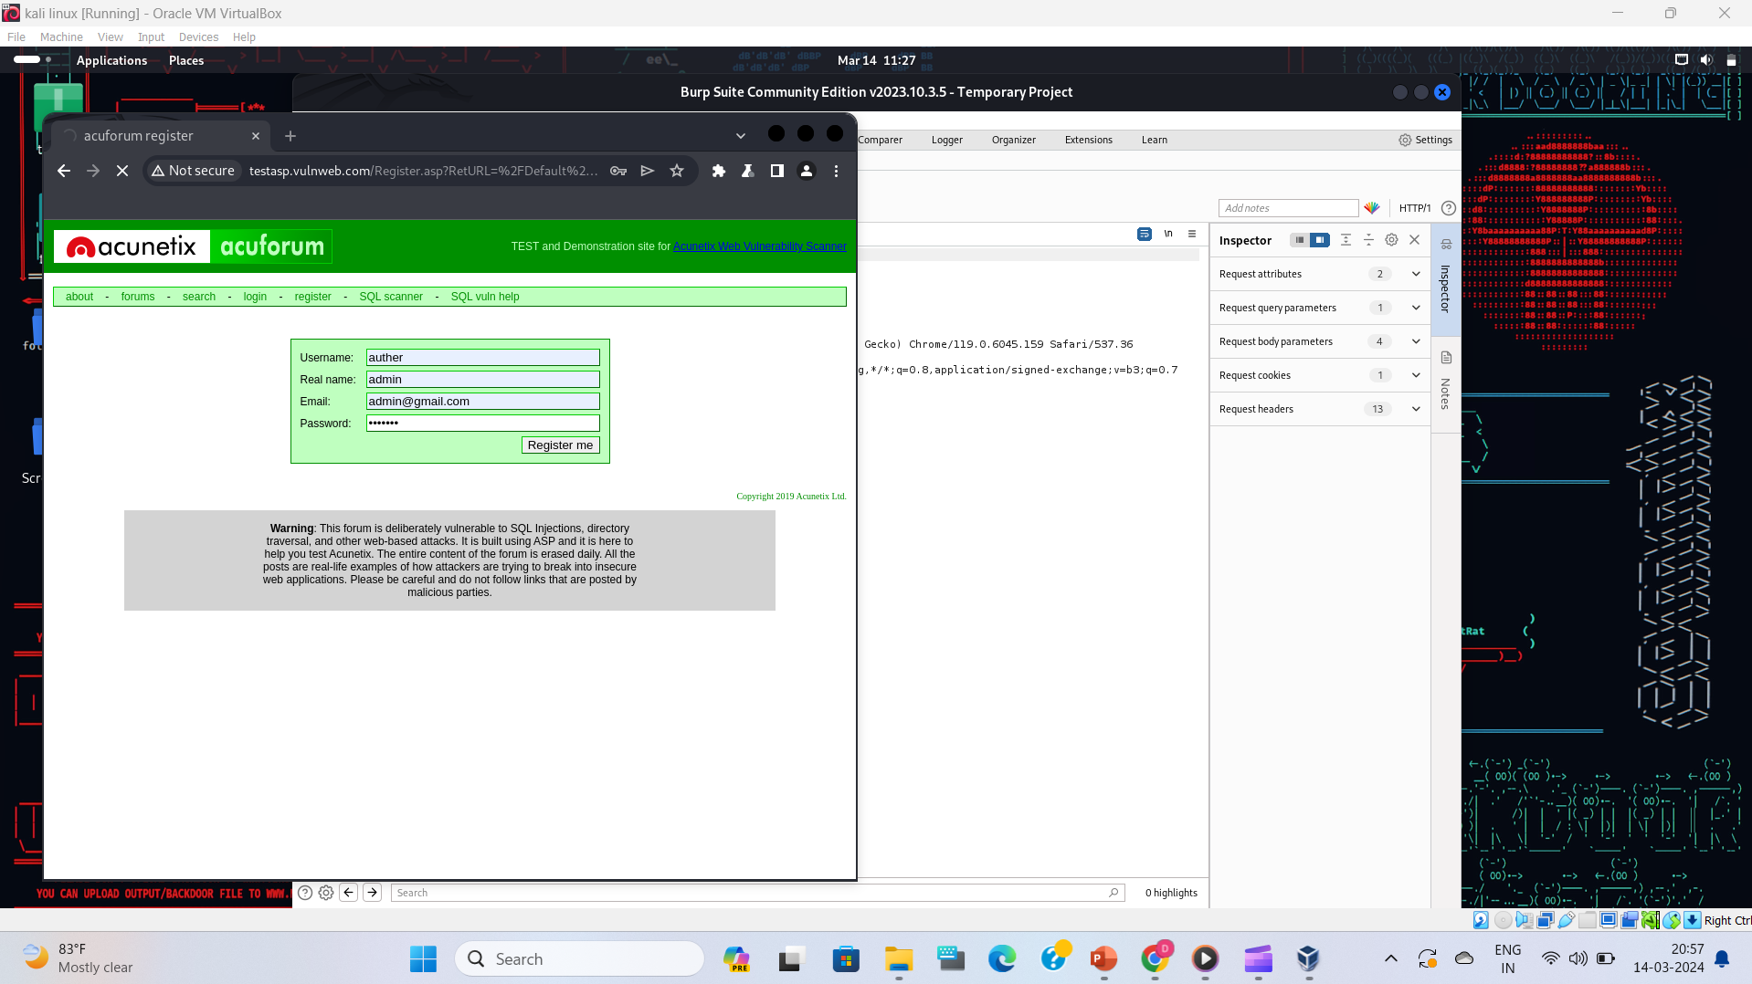

Slide 5
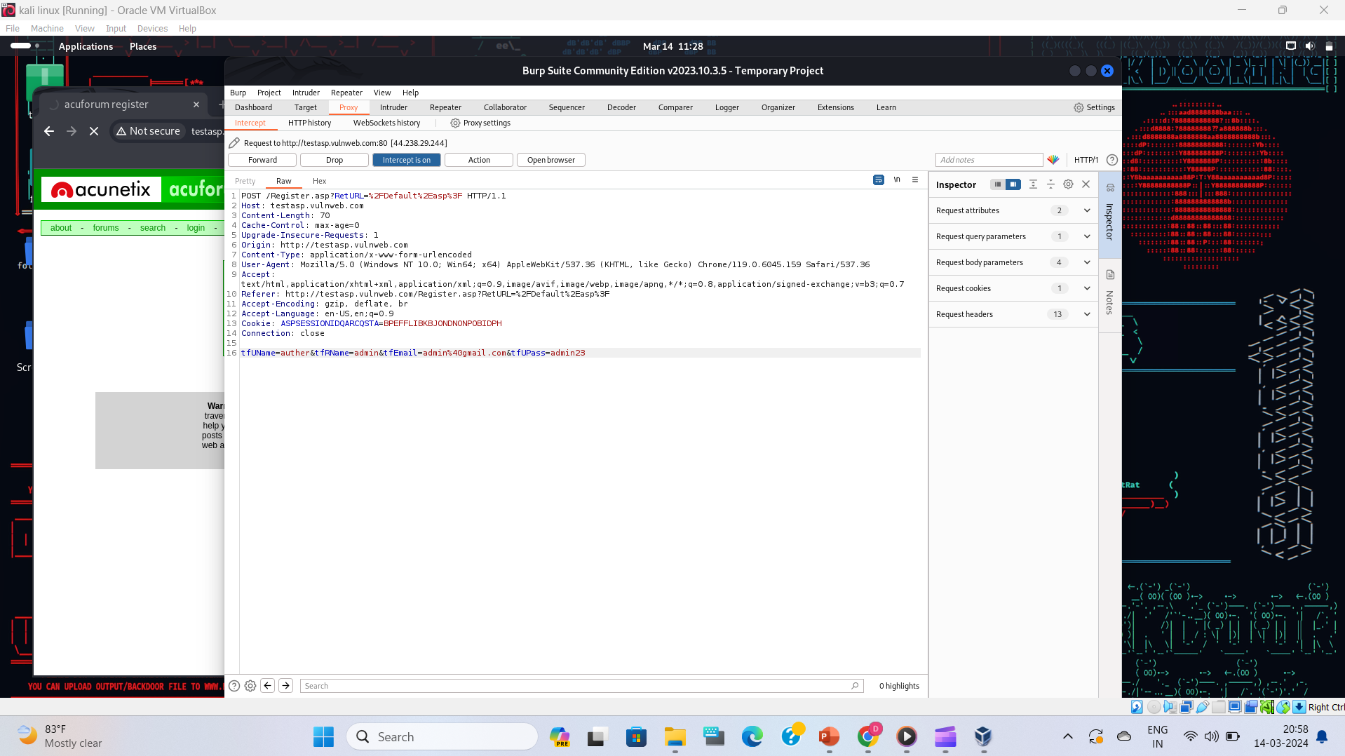

Slide 6
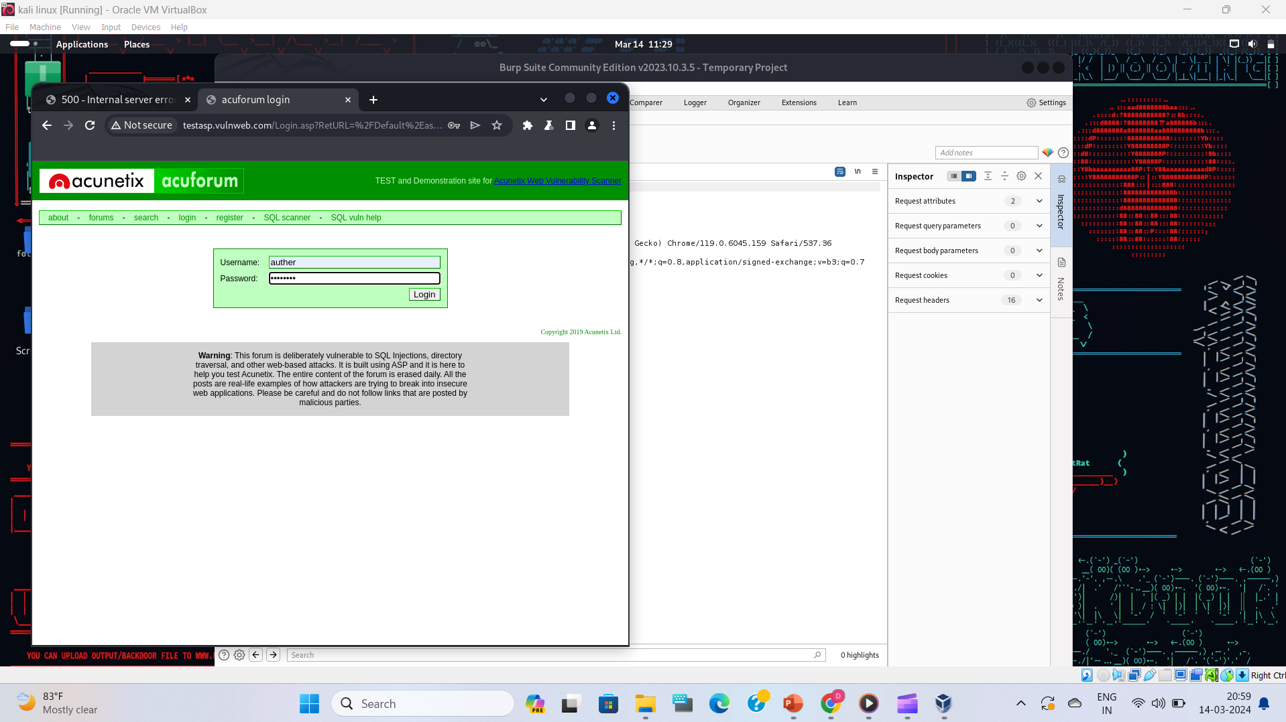

Slide 7
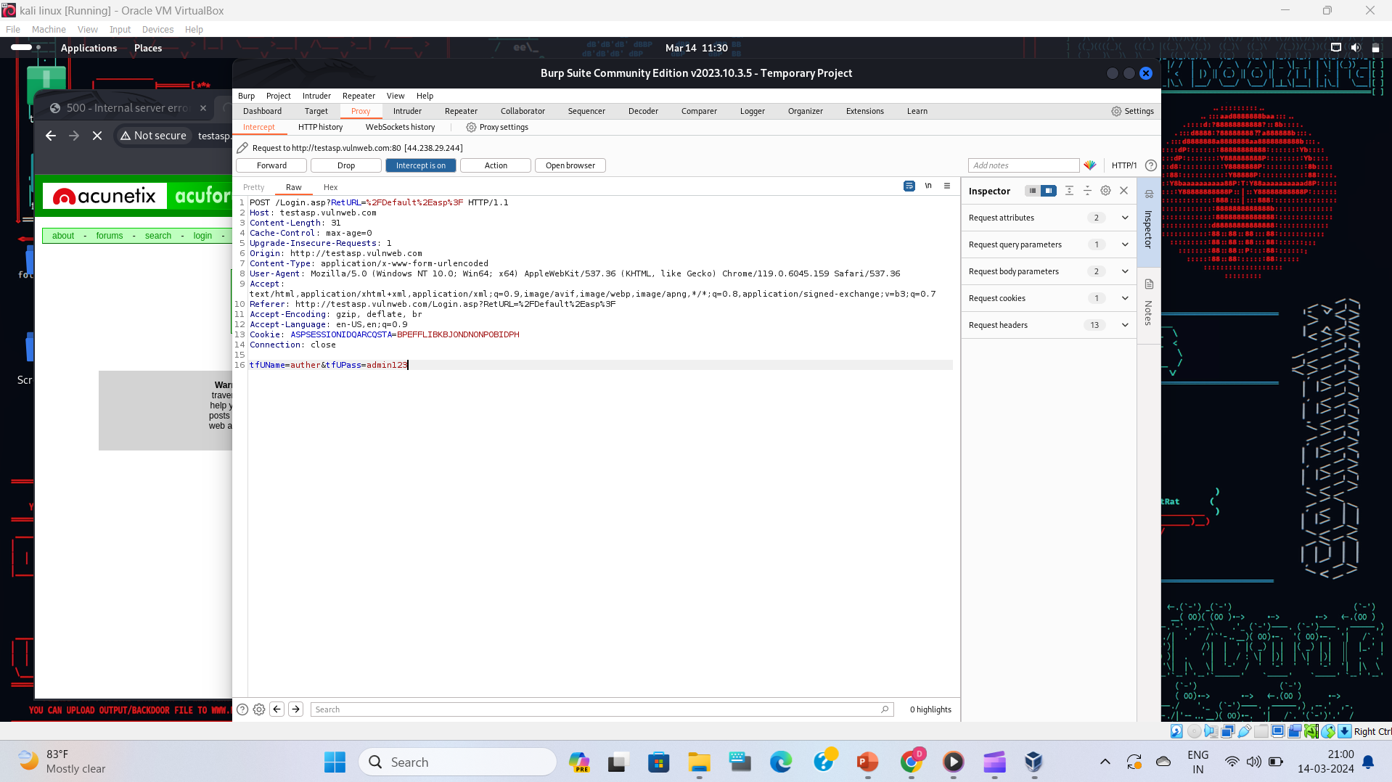

Slide 8
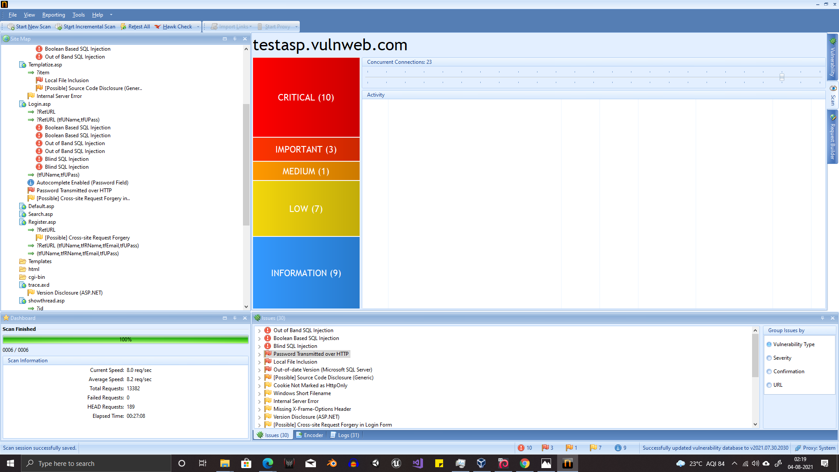

Slide 9
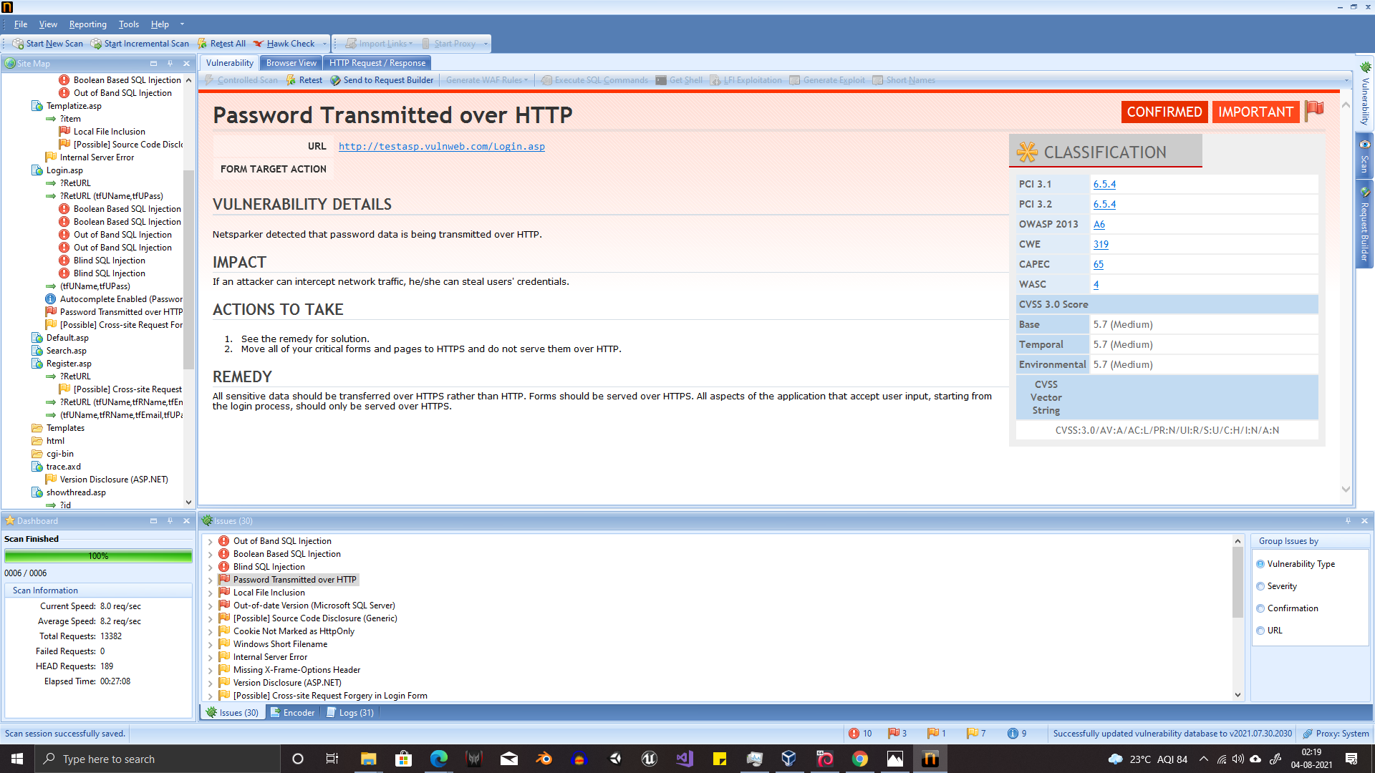

Slide 10
Thank You

